Slide 1
Android Controlled HomE automation

Slide 2
Introduction
In our Iot based project we tried to explore the area of home automation making use of Rapberry pi and Arduino . this is a simple prototype of what the actual product would represent .
Our product notifies the user whenever someone is standing infront the users door.it captures the images of the person standing infront the door and sends it to the user . The user on receiving the photos of the person can control the opening and closing of the door as he wishes with the help of an android app .

Slide 3
Functionalities
1.Detecting the presence of a person infront the door
2.Capturing photos of the person
3.Sending push notifications to the user
4.Controlling the Door via Application
5.Extensible platform for future enhancement

Slide 4
Design
1. we attached the ultrasonic sensor to the gpio pins of the raspberry pi and made it work in a way such that it would be able to detect objects in distances within 100 cm .
2. For the purpose of capturing photos we needed a camera module . raspberry pi comes with an inbuilt camera module so we didn’t make use of any external camera
3. we made use of python’s email package which sends those photos to as attachments to the user in the form of a push notification
4. For making the gate we made use of Arduino whose pins have been connected to the servomotor .We have used arduino’s Bluetooth module to make it discoverable . when the Arduino receives information from the mobile device it rotates the servo hence resulting in the opening and closing of the gate

Slide 5
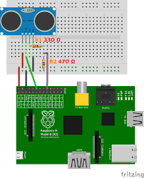
Hardware Schematic
Connection between the pi and sensor

Slide 6
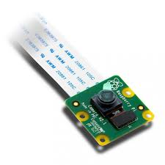
The inbuilt camera module for the raspberry pi

Slide 7
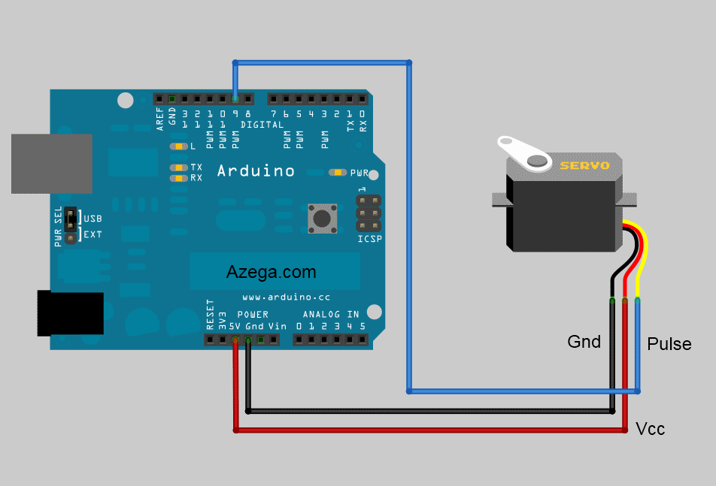
Connection of the Arduino with the servo .

Slide 8
Uses
The system integrated with different features can be applied in the following fields.
The system can be used from home to offices to control the Doors according to the users needs.
For the development of technology friendly environment The system incorporates the use of technology and making smart home automation. By the use of day to day gadgets we can utilize them for different prospective.

Slide 9
Limitations
One limitation of using ultrasonic sensors is that fact that it is used to detect the presence of any kind of object and not only a human object . So cases might arrive where sensors trigger the camera to take photos which ultimately turn out to be useless hence wasting the users time

Slide 10
Further enhancements
To overcome the limitation of our project we can integrate image processing into our product . we can use image processing libraries like opencv and run a face detection algorithm which will tell the product to send notifications to the user only when a face is detected in the picture hence making sure the user only receives photos of human objects.

Slide 11
Conclusion
The prime objective of our project is to use the Smartphone to control the users door effectively. The user receives photos of the person standing infront his/her gate via a push notification .after receiving these photos he can easily control the opening /closing of the gate via an android app .

